Slide 1
PROJECT PRESENTATION
GAME OF THE AMAZONS
Available on: https://github.com/ehadziabdic/GameOfTheAmazons

Slide 2
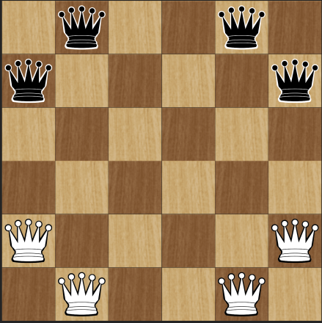
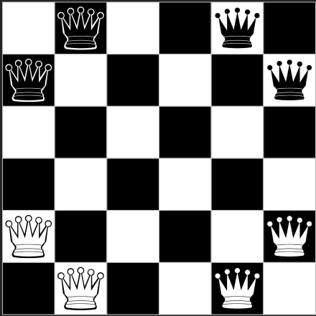
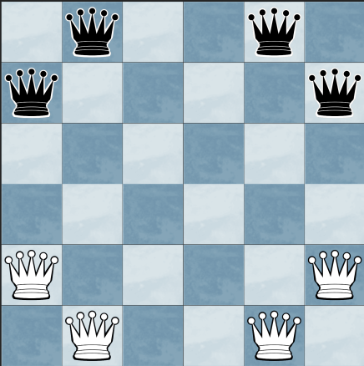
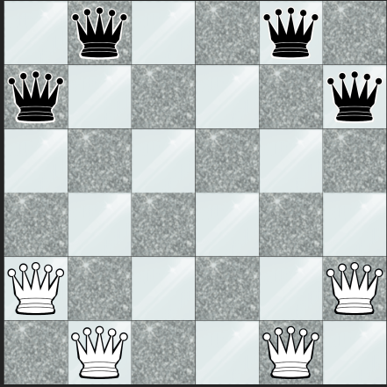
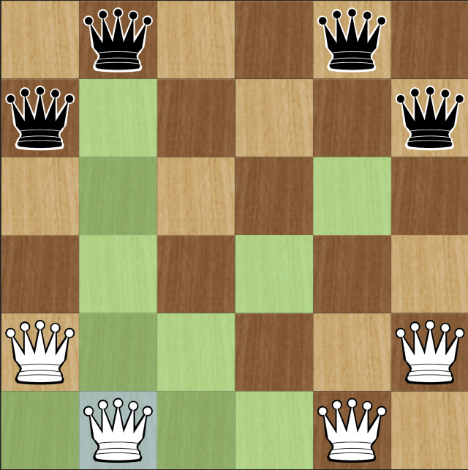
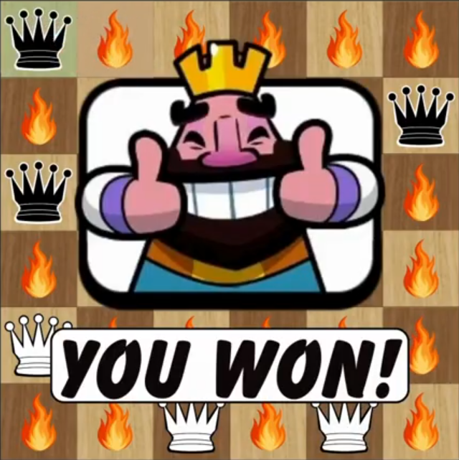
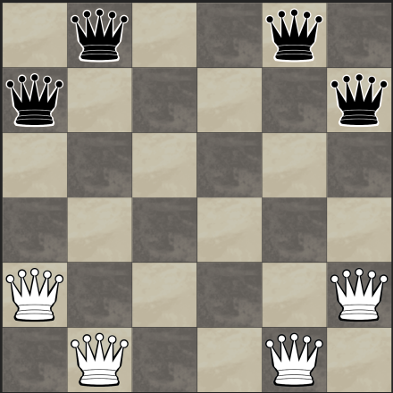
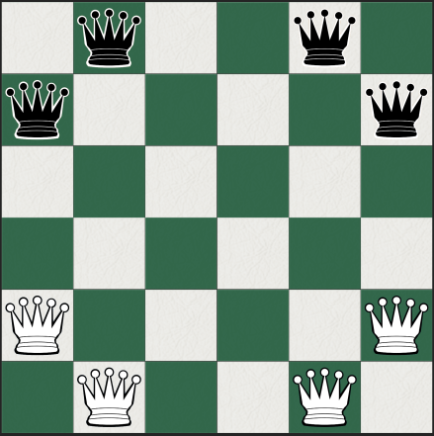
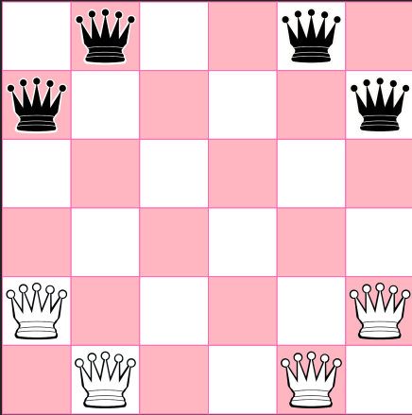
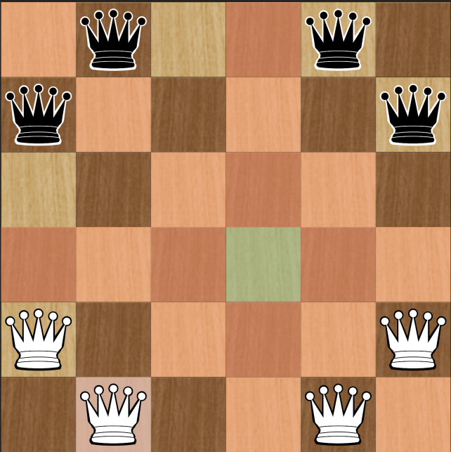
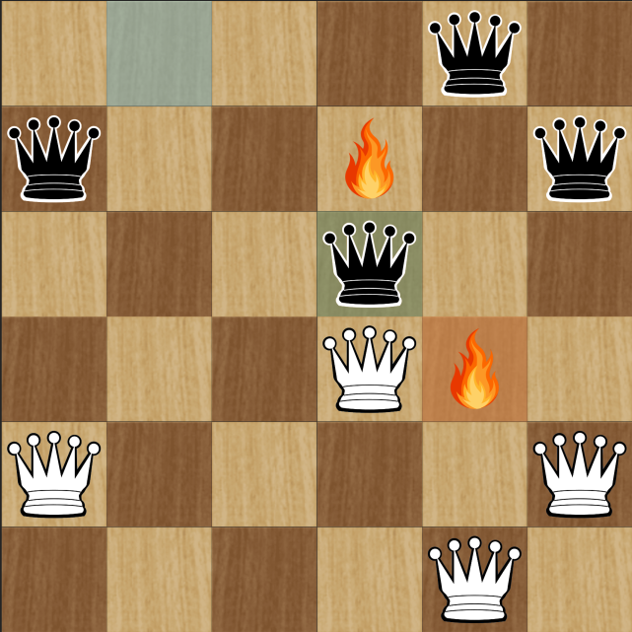
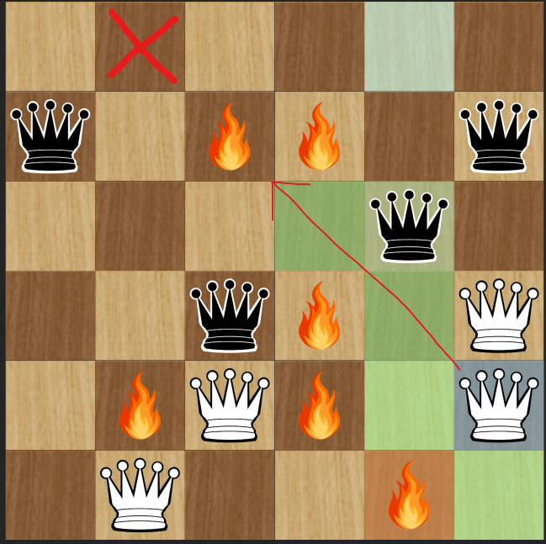
Game of The Amazons
Available Board Styles
Each player have two moves to play(queen, arrow)
Once an arrow lands on tile, that tile is permanently blocked for the rest of the game.
No one can move or shoot through blocked tile.
The goal is to be the last player able to make a move. You win when your opponent is completely trapped and has no legal moves left.
Legal moves for Amazon
Legal moves for the arrow
Old position of opponent
New position of opponent
Current position
Opponent’s new fire position

Slide 3
Available Features and Game Controls
Core Game Rules: Queen and Arrow placement, Path logic.
Board Sizes: Small (6x6), Medium (8x8), Large (10x10)
Board Styles: 7 styles + custom theme creator tool
Game Modes: PvP, PvAI, AIvAI(Spectator mode)
Difficulty Levels: Easy, Medium, and Hard.
Languages: 6 available (Bosnian, English, German, Japanese…)
AI Engine: Minimax with Alpha-Beta pruning (+ Selective Deepening)
Heuristics: Spatial Influence & Territory Score
Basic GUI: Responsive interface, interactive Queens, move highlights.
Audio/Visuals: Core animations for movement/explosions and basic sound effects.
Full Compatibility: App is compatible with windows, mac-os and linux
Undo System: A state-stack implementation that allows players to take back their last move.
Stop AI Functionality: Safety feature to stop deep calculations safely.
New game: Clears board state
Navigation: Three page system (game, history, rules)
Animation speed slider for Spectator mode
Notes:
We are going to show you some of these now

